Slide 1
ALTERNATING CURRENT AND VOLTAGE

Slide 2
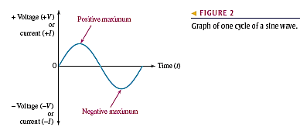
THE SINUSOIDAL WAVEFORM
The voltage or current fluctuates according to a certain pattern called a waveform.
An alternating voltage is one that changes polarity at a certain rate, and an alternating current is one that changes direction at a certain rate.

Slide 3
THE SINUSOIDAL WAVEFORM
The sinusoidal waveform sine wave is the fundamental type of alternating current (ac) and alternating voltage.
The sine wave is a periodic type of waveform that repeats at fixed intervals.

Slide 4
THE SINUSOIDAL WAVEFORM
In addition, other types of repetitive waveforms are composites of many individual sine waves called harmonics.

Slide 5
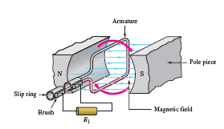
THE SINUSOIDAL WAVEFORM
The Sinusoidal voltages are produced by two types of sources:
Rotating electrical machines (Alternators)
(Ac generators)
Alternators are used in nearly all modern automobiles, trucks, tractors, and other vehicles.

Slide 6
Electronic Signal Generators
The signal generator is an instrument that electronically produces sine waves for use in testing or controlling electronic circuits and systems.
All signal generators consist of an oscillator, which is an electronic circuit that produces repetitive waves.
All generators have controls for adjusting the amplitude and frequency.

Slide 7
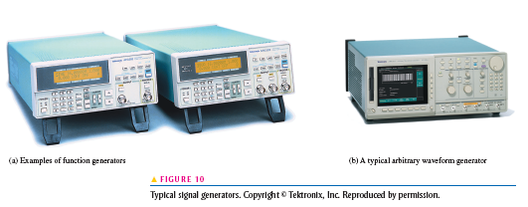
Function generator
It is an instrument that produces more than one type of waveform. It provides pulse waveforms as well as sine waves and triangular waves.

Slide 8
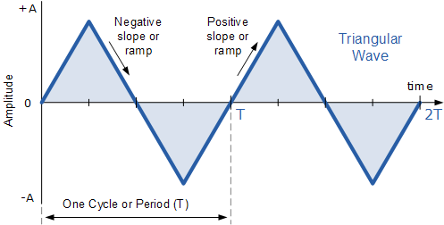
Electronic Signal Generators
An arbitrary waveform generator can be used to generate standard signals like sine waves, triangular waves, and pulses as well as signals with various shapes and characteristics.

Slide 9
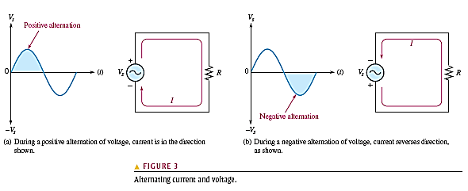
Polarity of a Sine Wave
The combined positive and negative alternations make up one cycle of a sine wave.

Slide 10
Period of a Sine Wave
The time required for a sine wave to complete one full cycle is called the period (T).

Slide 11
Period of a Sine Wave
The period of a sine wave can be measured from a zero crossing to the next corresponding zero crossing, as indicated in Figure 4(a).
The period can also be measured from any peak in a given cycle to the corresponding peak in the next cycle.

Slide 12
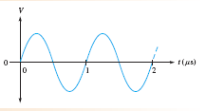
Period of a Sine Wave
EXAMPLE 1
Show three possible ways to measure the period of the sine wave in Figure 6. How many cycles are shown?

Slide 13
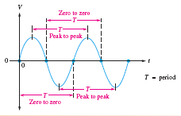
Period of a Sine Wave
Method 1: The period can be measured from one zero crossing to the corresponding zero crossing in the next cycle (the slope must be the same at the corresponding zero crossings).

Slide 14
Period of a Sine Wave
Method 2: The period can be measured from the positive peak in one cycle to the positive peak in the next cycle.

Slide 15
Period of a Sine Wave
Method 3: The period can be measured from the negative peak in one cycle to the negative peak in the next cycle.

Slide 16
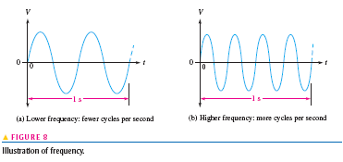
Frequency of a Sine Wave
Frequency (f ) is the number of cycles that a sine wave completes in one second.

Slide 17
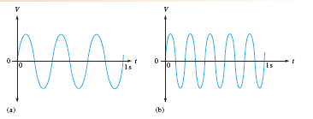
Frequency of a Sine Wave
EXAMPLE 2
Which sine wave in Figure 9 has a higher frequency? Determine the frequency and the period of both waveforms.
FIGURE 9

Slide 18
Frequency of a Sine Wave
In Figure 9(a), three cycles are completed in 1 s; therefore, f = 3 Hz
One cycle takes 0.333 s (one-third second), so the period is T = 0.333 s
FIGURE 9

Slide 19
Frequency of a Sine Wave
In Figure 9(b), five cycles are completed in 1 s; therefore, f = 5 Hz
One cycle takes 0.2 s (one-fifth second), so the period is T = 0.2 s
FIGURE 9

Slide 20
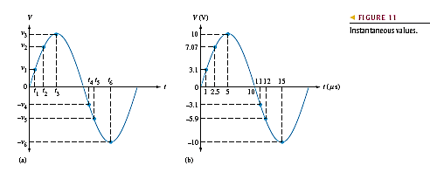
SINUSOIDAL VOLTAGE AND CURRENT VALUES
Instantaneous Value
Figure 11 illustrates that at any point in time on a sine wave, the voltage (or current) has an instantaneous value.

Slide 21
SINUSOIDAL VOLTAGE AND CURRENT VALUES
Instantaneous values of voltage and current are symbolized by lowercase v and i, respectively.

Slide 22
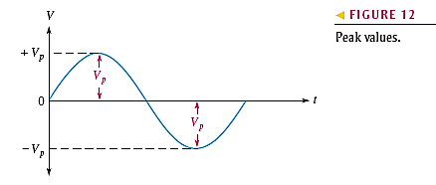
SINUSOIDAL VOLTAGE AND CURRENT VALUES
Peak Value: The peak value of a sine wave is the value of voltage (or current) at the positive or the negative maximum (peak) with respect to zero. also called the amplitude

Slide 23
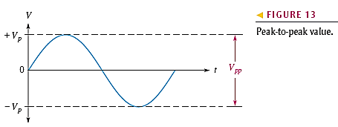
SINUSOIDAL VOLTAGE AND CURRENT VALUES
Peak-to-Peak Value : The peak-to-peak value of a sine wave, as shown in Figure 13, is the voltage or current from the positive peak to the negative peak. It is always twice the peak value as

Slide 24
SINUSOIDAL VOLTAGE AND CURRENT VALUES
RMS Value referred to as the effective value, of a sinusoidal voltage is actually a measure of the heating effect of the sine wave.
Most ac voltmeters display rms voltage.

Slide 25
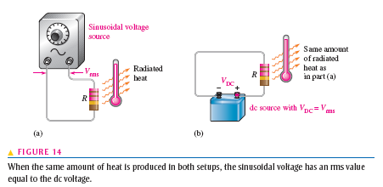
SINUSOIDAL VOLTAGE AND CURRENT VALUES
The rms value of a sinusoidal voltage is equal to the dc voltage that produces the same amount of heat in a resistance as does the sinusoidal voltage.

Slide 26
SINUSOIDAL VOLTAGE AND CURRENT VALUES
The peak value of a sine wave can be converted to the corresponding rms value using the following relationships for either voltage or current:

Slide 27
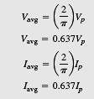
SINUSOIDAL VOLTAGE AND CURRENT VALUES
The average value of a sine wave taken over one complete cycle is always zero because the positive values (above the zero crossing) offset the negative values (below the zero crossing).
The average value is the total area under the half-cycle curve divided by the distance in radians of the curve along the horizontal axis.
The result is derived in Appendix B

Slide 28
ANGULAR MEASUREMENT OF A SINE WAVE
A sinusoidal voltage can be produced by an ac generator. There is a direct relationship between the rotation of the rotor in an alternator and the sine wave output.
Thus, the angular measurement of the rotor’s position is directly related to the angle assigned to the sine wave.

Slide 29
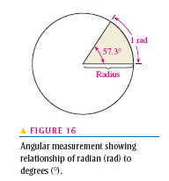
ANGULAR MEASUREMENT OF A SINE WAVE
Angular Measurement:
A degree is an angular measurement corresponding to 1/360º of a circle or complete revolution.

Slide 30
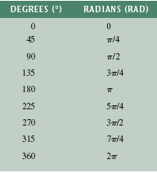
ANGULAR MEASUREMENT OF A SINE WAVE
Table 1 lists several values of degrees and the corresponding radian values.

Slide 31
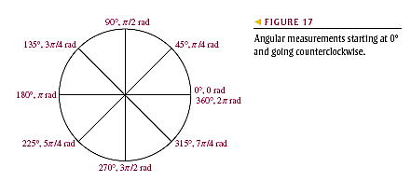
ANGULAR MEASUREMENT OF A SINE WAVE
These angular measurements are illustrated in Figure 17.

Slide 32
ANGULAR MEASUREMENT OF A SINE WAVE
Radian/Degree Conversion
Degrees can be converted to radians.
Radians can be converted to degrees.

Slide 33
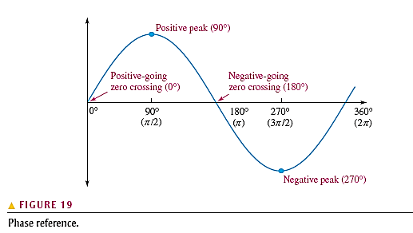
Phase of a Sine Wave
When the sine wave is shifted left or right with respect to this reference, there is a phase shift.

Slide 34
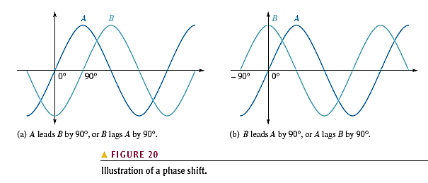
Phase of a Sine Wave

Slide 35
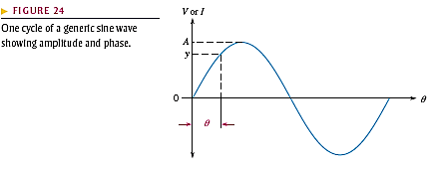
The Sine Wave Formula
The sine wave amplitude (A) is the maximum value of the voltage or current on the vertical axis; angular values run along the horizontal axis.
The variable y is an instantaneous value that represents either voltage or current at a given angle ϴ

Slide 36
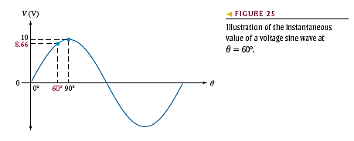
The Sine Wave Formula
The instantaneous voltage at a point along the horizontal axis as follows, where y = v and A = Vp

Slide 37
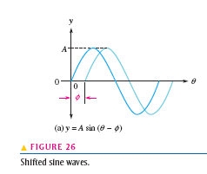
Expressions for Phase-Shifted Sine Waves
When a sine wave is shifted to the right of the reference (lagging) by a certain angle φ, as in figure 26(a). The general expression is

Slide 38
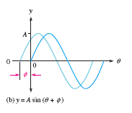
Expressions for Phase-Shifted Sine Waves
When a sine wave is shifted to the left of the reference (leading) by a certain angle, φ, as shown in Figure 26(b), the general expression is

Slide 39
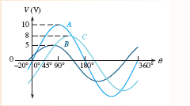
Expressions for Phase-Shifted Sine Waves
EXAMPLE
Determine the instantaneous value at the reference point on the horizontal axis for each voltage sine wave in Figure 27

Slide 40
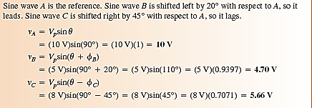
Expressions for Phase-Shifted Sine Waves

Slide 41
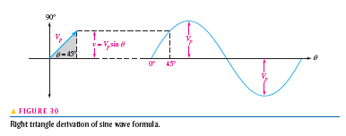
Phasor Representation of a Sine Wave
The length of the phasor is the peak value of the sinusoidal voltage Vp, Thus, the opposite side of the triangle,
which is the instantaneous value,
can be expressed as

Slide 42
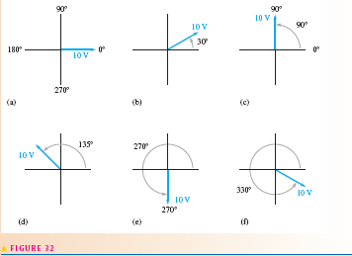
Phasor Representation of a Sine Wave
EXAMPLE: For the Phasor in each part of Figure 32, determine the instantaneous voltage value. The length of each represents the peak value of the sinusoidal voltage..

Slide 43
Phasor Representation of a Sine Wave
(A) v = (10 V)sin 0° = (10 V)(0) = 0 V
(B)v = (10 V)sin 30° = (10 V)(0.5) = 5 V
(C )v = (10 V)sin 90° = (10 V)(1) = 10 V

Slide 44
Phasor Representation of a Sine Wave
v = (10 V)sin 135° = (10 V)(0.707) = 7.07 V
v = (10 V)sin 270° = (10 V)(-1) = - 10 V
v = (10 V)sin 330° = (10 V)(-0.5) = - 5 V

Slide 45
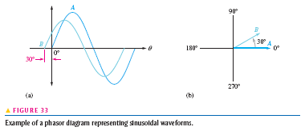
Phasor Diagrams
A phasor diagram can be used to show the relative relationship of two or more sine waves of the same frequency.

Slide 46
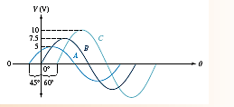
Phasor Diagrams
Example: Use a phasor diagram to represent the sine waves in Figure 34.

Slide 47
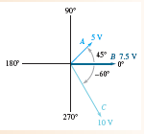
Phasor Diagrams
Solution: The phasor diagram representing the sine waves is shown in Figure 35.

Slide 48
Angular Velocity of a Phasor
Since, one cycle of a sine wave is traced out when a phasor is rotated through 360⁰ or 2π radians in a time equal to the period, T, the angular velocity (distance/time) can be expressed as.

Slide 49
Angular Velocity of a Phasor
When a phasor is rotated at an angular velocity then t is the angle through which the phasor has passed at any instant.
Therefore, the following relationship can be stated:

Slide 50
Angular Velocity of a Phasor

Slide 51
ANALYSIS OF AC CIRCUITS
When a time-varying ac voltage such as a sinusoidal voltage is applied to a circuit, Ohm’s law, Kirchhoff’s
laws, and the power formulas apply to ac circuits in the same way that they apply to dc circuits.
Power in resistive ac circuits
is determined the same
as for dc circuits except
that you must use rms values
of current and voltage.

Slide 52
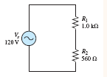
ANALYSIS OF AC CIRCUITS
Example: Determine the rms voltage across each resistor and the rms current in Figure 39. The source voltage is given as an rms value. Also determine the total power.

Slide 53
ANALYSIS OF AC CIRCUITS

Slide 54
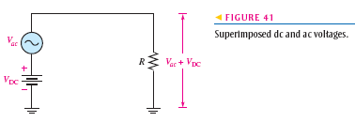
Superimposed DC and AC Voltages
Amplifier circuits are example of ac signal voltages superimposed on dc operating voltages.
This is a common application of the superposition theorem.

Slide 55
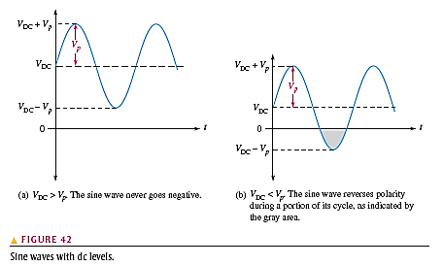
Superimposed DC and AC Voltages
These two voltages will add algebraically to produce an ac voltage “riding” on a dc level, as measured across the resistor.

Slide 56
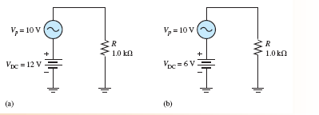
Superimposed DC and AC Voltages
Example: Determine the maximum and minimum voltage across the resistor in each circuit of figure 43.

Slide 57
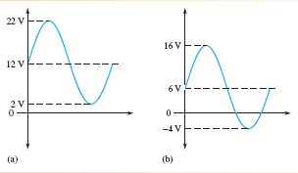
Superimposed DC and AC Voltages
In Figure 43(a), the maximum voltage across R is
Vmax = VDC + Vp = 12 V + 10 V = 22 V
The minimum voltage across R is
Vmin = VDC - Vp = 12 V - 10 V = 2 V
Therefore, VR(tot) is an-alternating sine wave that varies from +22 V to +2 V, as shown in Figure 44(a).

Slide 58
Superimposed DC and AC Voltages
In Figure 43(b), the maximum voltage across R is
Vmax = VDC + Vp = 6 V + 10 V = 16 V
The minimum voltage across R is
Vmin = VDC - Vp = - 4 V
Therefore, VR(tot) is an alternating sine wave that varies from +16 V to - 4 V as shown in Figure 44(b).

Slide 59
NONSINUSOIDAL WAVEFORMS
Two major types of waveforms are the pulse waveform and the triangular waveform.

Slide 60
NONSINUSOIDAL WAVEFORMS
In Figure 53, the pulses repeat at regular intervals. The rate at which the pulses repeat is the pulse repetition frequency, which is the fundamental frequency of the waveform. f = 1/T.

Slide 61
NONSINUSOIDAL WAVEFORMS
Square Waves :
A square wave is a pulse waveform with a duty cycle of 50%. Thus, the pulse width is equal to one-half of the period. A square wave is shown in Figure 55

Slide 62
NONSINUSOIDAL WAVEFORMS
An important characteristic of repetitive pulse waveforms is the duty cycle.
The duty cycle is the ratio of the pulse width (tW) to the period (T) and is usually expressed as a percentage.

Slide 63
NONSINUSOIDAL WAVEFORMS
The Average Value of a Pulse Waveform: The average value (Vavg)of a pulse waveform is equal to its baseline value plus its duty cycle times its amplitude.

Slide 64
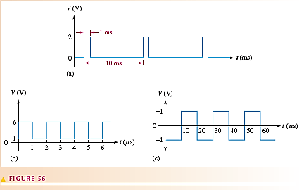
NONSINUSOIDAL WAVEFORMS
Example : Determine the average value of each of the waveforms in Figure 56.

Slide 65
NONSINUSOIDAL WAVEFORMS
In Figure 56(a), the baseline is at 0 V, the amplitude is 2 V, and the duty cycle is 10%. The average value is
V(avg) = baseline + (duty cycle)(amplitude)
= 0 V + (0.1)(2 V) = 0.2 V

Slide 66
NONSINUSOIDAL WAVEFORMS
The waveform in Figure 56(b) has a baseline of +1 V, an amplitude of 5 V and a duty cycle of 50%. The average value is
V(avg) = baseline + (duty cycle)(amplitude)
= 1 V + (0.5)(5 V) = 1 V + 2.5 V = 3.5 V

Slide 67
NONSINUSOIDAL WAVEFORMS
Figure 56(c) shows a square wave with a baseline of
-1 V and an amplitude of 2 V. The average value is
Vavg = baseline + (duty cycle)(amplitude)
= -1 V + (0.5)(2 V) = -1 V + 1 V = 0 V
This is an alternating square wave, and, as with an alternating sine wave, it has an average of zero.

Slide 68
NONSINUSOIDAL WAVEFORMS
Triangular Waveforms:
The period of this waveform is measured from one peak to the next corresponding peak, as illustrated. This particular triangular waveform is alternating and has an average value of zero.

Slide 69
NONSINUSOIDAL WAVEFORMS
Figure 60 depicts a triangular waveform with a nonzero average value. The frequency for triangular waves is determined in the same way as for sine waves, that is, f = 1/T.

Slide 70
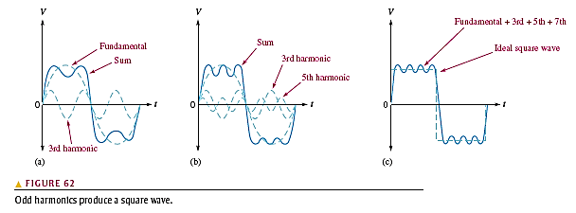
NONSINUSOIDAL WAVEFORMS
Harmonic: The fundamental frequency is the repetition rate of the waveform, and the harmonics are higher frequency sine waves that are multiples of the fundamental. (See Ref.)

